Slide 1
Liver Disease in Canada: A Crisis in the Making
An Assessment of Liver Disease in Canada
Summary of a report prepared by the Canadian Liver Foundation, March 2013

Slide 2
Hepatitis B
Hepatitis B
2

Slide 3
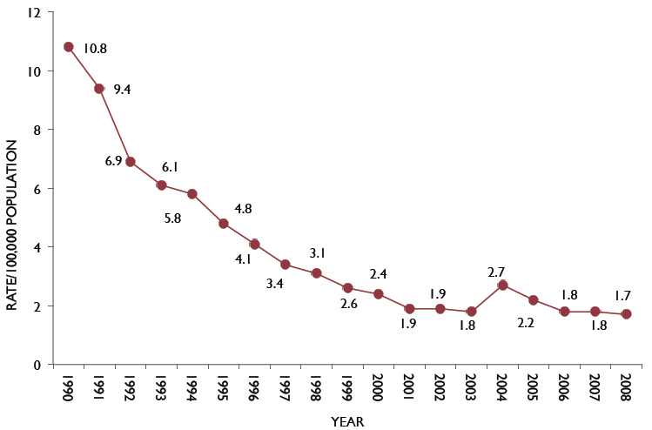
Incidence of acute hepatitis B is declining
Acute hepatitis B infection rate over time
Indeterminate cases are cases in which neither acute hepatitis B nor chronic hepatitis B could be determined with certainty. This may have been
due to confusing serological tests or to inadequate follow-up.
http://www.phac-aspc.gc.ca/id-mi/hepatitisBCan-hepatiteBCan-eng.php
Notes:
The rate of acute hepatitis B has been declining for a number of years. However, this graph does not represent all new infections. The data only reflects symptomatic cases and the few cases identified because of seroconversion. The true new infection rate is unknown.

Slide 4
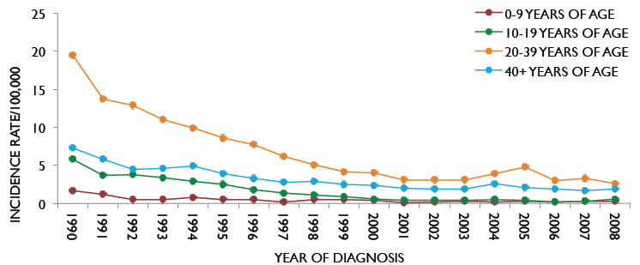
Vaccinated age groups show the greatest decline in acute hepatitis B
Acute hepatitis B infection rate by time and by age group
Indeterminate cases are cases in which neither acute hepatitis B nor chronic hepatitis B could be determined with certainty. This may have been
due to confusing serological tests or to inadequate follow-up.
http://www.phac-aspc.gc.ca/id-mi/hepatitisBCan-hepatiteBCan-eng.php
Notes:
This graph shows that the biggest decline in acute hepatitis B is in the 20-30 age groups, i.e., those most at risk for sexual transmission of disease, and the age group that has largely been vaccinated. Older age groups, such as those above 40 years have also seen a decline, but not as dramatically. This group is mostly unvaccinated. In the very young acute hepatitis B was never highly prevalent, but has now virtually disappeared.

Slide 5
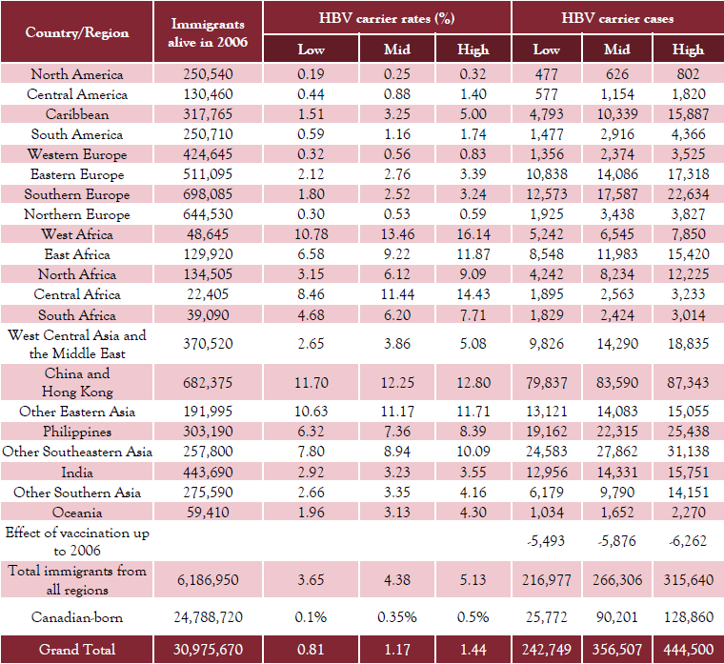
Prevalence of chronic hepatitis B in Canadian immigrants
Leber et al. The prevalence of hepatitis B in Canada. Submitted manuscript
Notes:
This table shows the number of immigrants to Canada coming from various parts of the world, and the prevalence of hepatitis B in their native country as assessed by meta-analysis, and the derived number of immigrants in Canada with chronic hepatitis B.

Slide 6
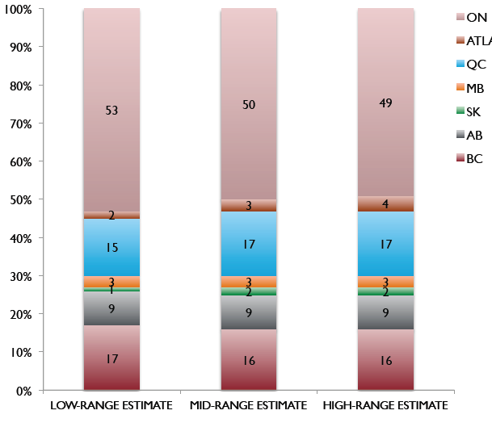
Distribution of chronic hepatitis B in the top 7 provinces
Ontario
Atlantic Canada
Quebec
Manitoba
Saskatchewan
Alberta
British Columbia
Leber et al. The prevalence of hepatitis B in Canada.
Submitted manuscript
Notes:
This graph shows the provincial distribution of hepatitis B in Canada. The numbers were derived from the data presented in the previous slide. Ontario has approximately 50% of all chronic hepatitis B in Canada

Slide 7
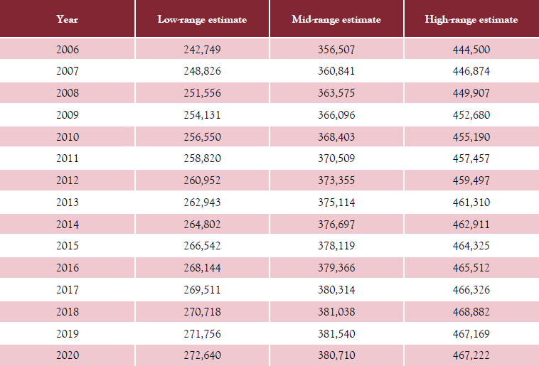
Predicted number of hepatitis B-infected persons in Canada to 2020
Leber et al. The prevalence of hepatitis B in Canada. Submitted manuscript
Notes:
This table shows the effect of continued immigration from high hepatitis B prevalence areas to Canada. Each year there will be additional new cases of hepatitis B coming to Canada.

Slide 8
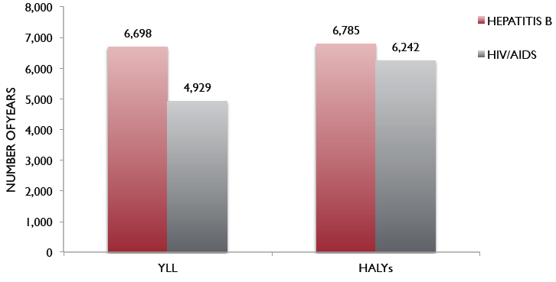
Mortality and morbidity of hepatitis B compared to HIV/AIDS
Years of life lost
Health-adjusted years of life lost
Kwong et al. Ontario Burden of Infectious Disease Study 2010
http://www.ices.on.ca/file/ONBOIDS_FullReport_intra.pdf
Notes:
The ONBOID Study (a modeling study) found that hepatitis B caused more morbidity and mortality than HIV.

Slide 9
Differences in time of licensing drugs for hepatitis B in Canada versus US/EU
Total time difference | Lamivudine | Adefovir | Entecavir | Telbivudine | Tenofovir | PegIFN alfa
Versus USA | 21 days after | 341 days after | 444 days after | 34 days after | 508 days after | 301 days after
Versus EU | 244 days before | 174 days after | 10 days before | 147 days before | 406 days after | 433 days after
Information provided by Gilead Sciences Canada Inc.
Notes:
Licensing and reimbursement of drugs in Canada is a lengthy and complex process. This table shows the interval between licensing in the USA and European Union and Canada. The drugs are listed in order of date of licensing (lamivudine first, followed by the others). It seems that the delays are getting worse.

Slide 10
Time in review by the common drug review
Drug | Time in review (months)
Adefovir | 18
Entecavir | 11
Telbivudine | 6 (not approved)
Tenofovir | 6
Notes:
This table shows the duration of review by the Common Drug Review. Some reviews take an unacceptably long time

Slide 11
Reimbursement policies for hepatitis B drugs
 | Lamivudine | Adefovir | Entecavir* | Telbivudine | Tenofovir | Standard IFN | PegIFN
CDEC | No recommendation: (licensed before CDEC was established) | With LAM after development of LAM resistance | Recommended only for patients with cirrhosis | Not to be listed | Recommended only for patients with cirrhosis
BC | ALT and viral load requirement | LAM failure | As per CDEC | Not listed | As per CDEC | 24 wks renewable x 1 if responding | Not listed
AB
SK | Special application | As per CDEC | As per CDEC | Not listed | As per CDEC | 6 months only | 48 wks only
MB | No restriction | As per CDEC with exceptions | As per CDEC with exceptions | Not listed | As per CDEC with exceptions | Not listed | Not listed
ON | F3 or cirrhosis and age >40 yrs | LAM failure and F3 or cirrhosis only | Cirrhosis only (includes LAM resistance) | Not listed | Naive: cirrhosis only; LAM resistance: F3 and cirrhosis | 24 wks (eAg+); 48 wks (antiHBe+); No cirrhosis | Not listed
QC | No restrictions |  |  | Not listed
NB | Elevated ALT (no restrictions for specialists) | LAM resistance | As per CDEC | Not listed | As per CDEC | Not listed | LAM resistance only
NS | Specialist application | Usual clinical restrictions only | As per CDEC | Not listed | As per CDEC | Specialist application | 24 wks renewable x 1
PEI** | No info available
NL | No info. available | As per CDEC | As per CDEC | As per CDEC | As per CDEC | No info. available
No recommendation:
(licensed before CDEC was established)
Restricted to internal medicine specialists and designated prescribers (except standard IFN, not listed)
Usual clinical restrictions only
Usual clinical restrictions only
CDEC = Canadian Drug Expert Committee
Sources = CADTH, provincial formularies, Kelly Kaita (personal communication)
*Ontario and other provinces allow entecavir to be used for LAM resistance despite all practice guidelines suggesting that entecavir is not appropriate for LAM resistance
**Only 96 cases of hepatitis B reported in PEI. Treatment status not known
Notes:
The table shows the reimbursement policies for hepatitis B drugs in each province. Note that Ontario has the most restrictive policies in Canada. This is unexpected since Ontario has the highest population of hepatitis B carriers by far.

Slide 12
Hepatitis B vaccination policies by province
Province | Universal immunization schedule | Other groups covered by provincial health ministries
British Columbia | Neonatal: age 2, 4, 6 months | High risk
Alberta | Grade 5 | High risk
Saskatchewan | Grade 6 | High risk
Manitoba | Grade 4 | High risk
Ontario | Grade 7 | High risk
Quebec | Grade 4 | High risk
New Brunswick | Neonatal and under age 10 | High risk
Nova Scotia | Grade 7 | High risk
Prince Edward Island | Neonatal: age 2, 4, 15 months | HCV infection; frequent users of blood products
Newfoundland | Grade 6 | High risk
The recommended vaccination schedule is neonatal vaccination at birth, 4 weeks and 6 months of age.
Only BC adheres fully to the recommended schedule.
The definition of high-risk groups is not uniform across provinces.
Sources = Provincial ministries of health (for details see full publication)
Notes:
No two provinces have the same hepatitis B vaccination schedule. The definition of high risk also varies by province. The ideal schedule is neonatal vaccination at birth, at one and 6 months. Only B.C. PEI and new Brunswick adhere to this schedule.

Slide 13
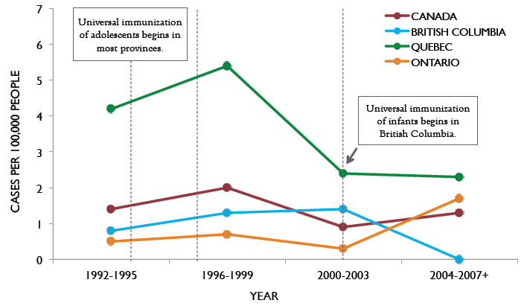
Reported incidence of acute HBV infection in infants: Canada 1992-2007
Macki CO et al. CMAJ 2009; 180:196-202
Notes:
This graph shows that in the province with neonatal vaccination (B.C.) the infant hepatitis B infection rate is falling. However, in Ontario, which only provides adolescent vaccination the infection rate in infants is increasing. Similarly in Canada the rate is increasing, probably because adolescent vaccination is the most common schedule across the country.

Slide 14
Hepatitis C

Slide 15
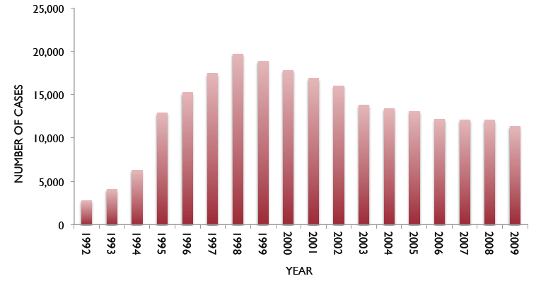
Cases of hepatitis C notified to Health Canada
Source: Public Health Agency of Canada (for details see full publication)
Notes:
The hepatitis C virus could only be tested for in 1991. Identification of cases reached a peak in 1998 and has been falling since. However, if the rate of decline in diagnosed cases continues to fall at the same rate it will be years before the yearly notification rate falls below 1,000. Notifications to Health Canada include acute and chronic cases and resolved infection. The criterion for notification is being anti-HCV positive.

Slide 16
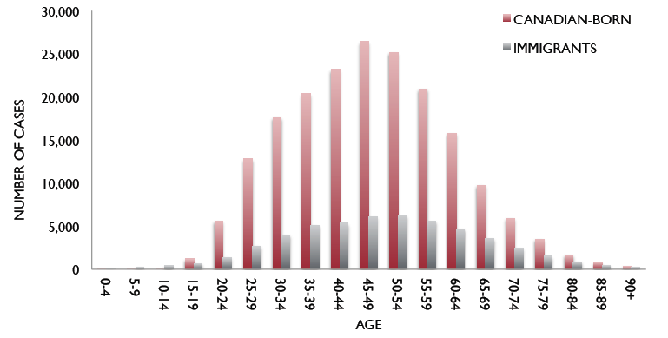
Modeled prevalence of hepatitis C in Canada by age cohort
Source: Public Health Agency of Canada (for details see full publication)
Notes:
This slide shows the age distribution of cases of chronic hepatitis C in immigrants and Canadian born. This age distribution is the justification for the CLF’s position statement that all individuals born between 1945 and 1975 should be tested once for hepatitis C.

Slide 17
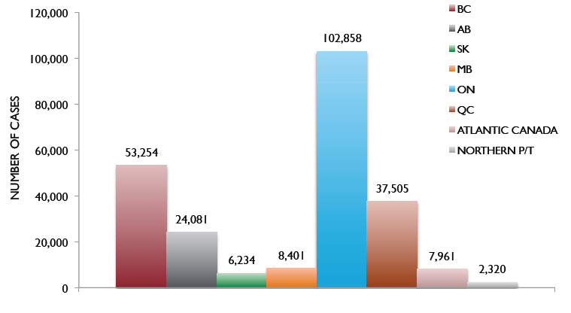
Provincial distribution of hepatitis C cases
Source: Public Health Agency of Canada (for details see full publication)
Notes:
The numbers for this graph are derived from modeling. Note that Ontario has more than 1/3 of all cases, about twice the number of the next province, B.C.

Slide 18
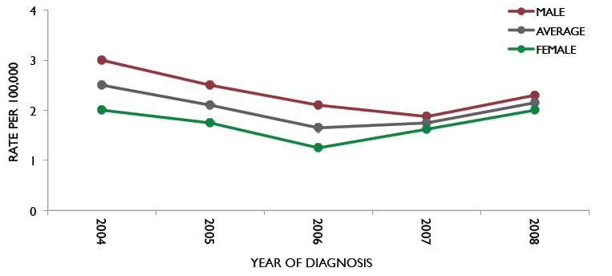
Incidence of acute hepatitis C
Source: Public Health Agency of Canada (for details see full publication)
Notes:
These data come from the Extended Hepatitis Strain Survey, which tracked all acute cases from health units representing about 50% of the population. However, urban areas such as Montreal and Toronto did not contribute to earlier data. This may account for the apparent increase in incidence as urban areas are likely to have a higher incidence than smaller population centers. Thus the increase in incidence apparent may be more than real.

Slide 19
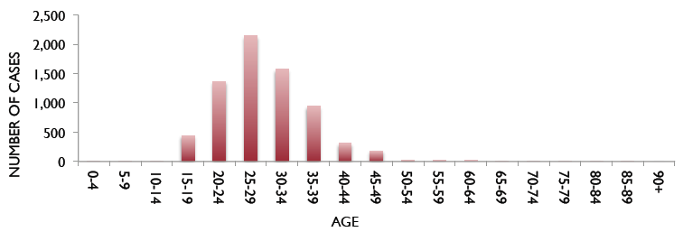
Modeled number of cases of acute hepatitis C by age
Source: Public Health Agency of Canada (for details see full publication)
Notes:
The peak age at which new hepatitis C infections occur is in the 20-34 age group, and is likely due to injection drug use which occurs in this age group.

Slide 20
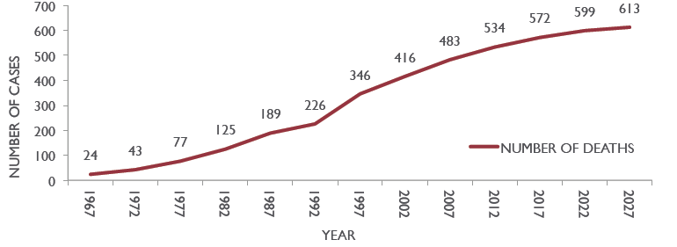
Modeled incidence of hepatitis C-related deaths
Source: Public Health Agency of Canada (for details see full publication)
Notes:
These numbers come from modeled data and are likely a large under-estimate. However the trend to increased mortality is clear and is similar to that reported in other countries.

Slide 21
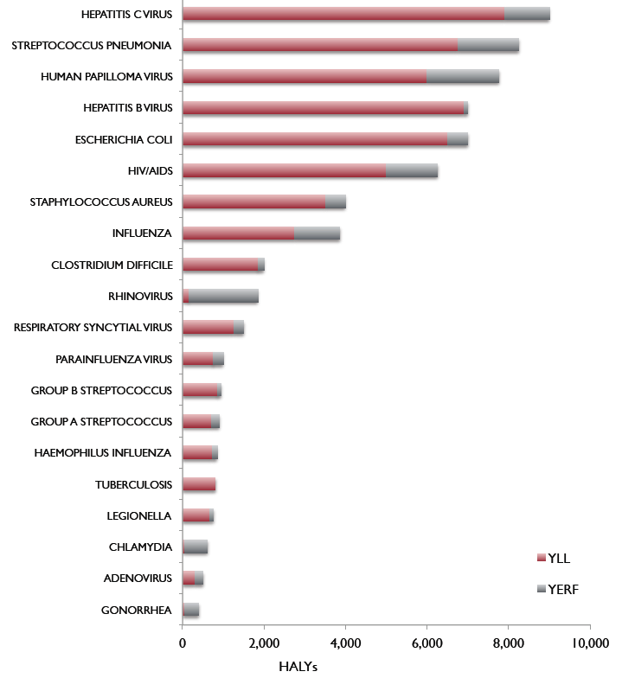
Impact of the top 20 pathogens in health-adjusted life years in Ontario
Years of life lost
Year equivalents of reduced functioning
Health-adjusted years of life lost
Notes:
This data comes from the ONBOID Study, a large scale modeling study looking at the morbidity and mortality from infectious diseases in Ontario. The disease causing the greatest mortality and morbidity was chronic hepatitis C.

Slide 22
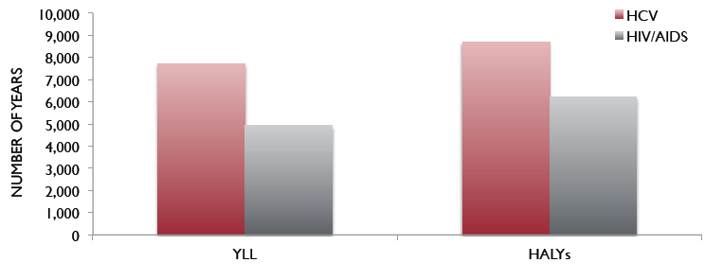
Health outcomes for hepatitis C and HIV/AIDS in Ontario
Years of life lost
Health-adjusted years of life lost
Source: Kwong et al. Ontario Burden of Infectious Disease Study 2010
http://www.ices.on.ca/file/ONBOIDS_FullReport_intra.pdf
Notes:
Hepatitis C causes more morbidity and mortality than HIV.

Slide 23
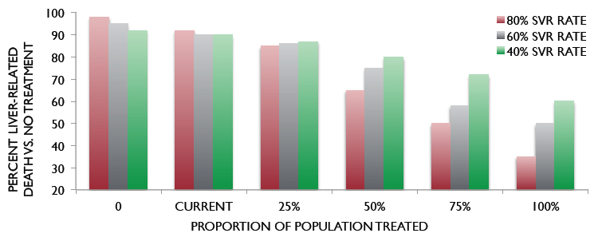
Reduction in hepatitis C-related deaths assuming increased treatment rates
Davis GL, et al. Gastroenterology 2010; 138:513-21
Notes:
This graph shows that in order to make a significant difference in the mortality from hepatitis C we need highly effective treatment and high uptake of treatment. Either alone will not have a major effect.

Slide 24
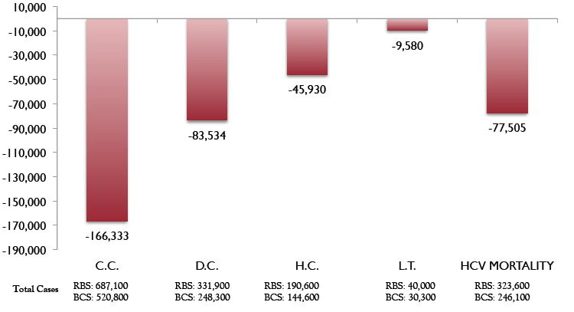
Outcomes with universal vs risk-based HCV screening in the USA
Source: McGarry et al. Hepatology 2012; 55:1344-55.
Notes:
This slide shows the reduction in the number of deaths, number of liver cancers and number of cases of cirrhosis that can be achieved by screening baby boomers for hepatitis C and treating the infected individuals. This is US data. For Canada the numbers should be approximately 10% of the US data.

Slide 25
Proportions of the infected population unaware of their infected status (USA)
Virus | Unaware of infection status (% of population)
Hepatitis B | ≈65%
Hepatitis C | ≈75%
Source: Hepatitis and Liver Cancer. Institute of Medicine. Washington. 2013
Notes:
These are estimates. The equivalent numbers for Canada are unknown, but are likely to be similar.

Slide 26
Reimbursement policies
 | PegIFN alfa plus ribavirin | Boceprevir | Telaprevir
CDEC | No restrictions | Fibrosis stage ≥F2 proven by liver biopsy
BC | ALT >1.5 x ULN | Fibrosis stage ≥F2 or elevated ALT* HIV co-infection by adjudication |  | Fibrosis stage ≥F2
AB | Recognized prescribers | No fibrosis restrictions* Null responders, HIV co-infection |  | No fibrosis restrictions
SK | No restrictions | As per CDEC,* null responders |  | As per CDEC
MB | No restrictions | Fibrosis stage ≥F2** or elevated ALT, Null responders |  | As per CDEC
ON | ALT >1.5 x ULN | Fibrosis stage ≥F2** HIV co-infection; Metavir score or equivalent |  | Null responders only
QC | No restrictions | No restrictions* |  | No restrictions*
NB | Internal medicine specialists | Fibrosis stage ≥F2;** specialist recommendation Null responders |  | As per CDEC
NS | Hepatologists | Fibrosis stage ≥F2;** specialist recommendation Null responders |  | Fibrosis stage ≥F2
PEI | Individual requests | Not listed |  | Not listed
NL | Internal medicine specialists | Not listed |  | Not listed
*No biopsy requirement
**Metavir score or equivalent in MB; by any method of fibrosis assessment in ON; biopsy or Fibroscan
where available in NB, NS
CDEC = Canadian Drug Expert Committee; ULN = upper limit of normal
Notes:
This table shows the reimbursement policies for drugs to treat hepatitis C. Most provinces have some form of restriction.

Slide 27
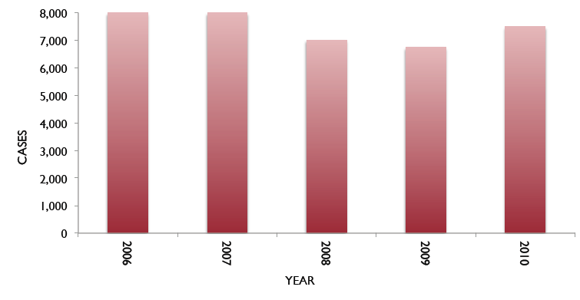
Patients treated for hepatitis C by year in Canada
Source: IMS Brogan Inc.
Notes:
Since about 2012 the number of patients treated has dropped dramatically as patients await newer interferon-free therapies.

Slide 28
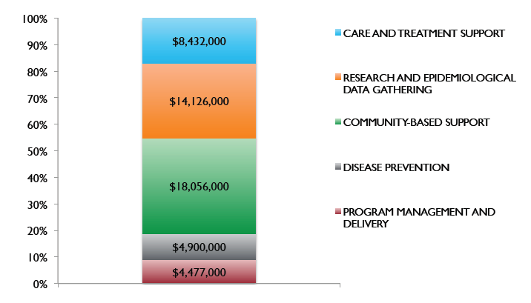
Expenditures by the Health Canada on hepatitis C programs, 1999-2004
In addition to PHAC, some provincial governments also have established programs
Source: Public Health Agency of Canada (for details see full publication)

Slide 29
Provincial government responses to hepatitis C
 | Department/Division | Activities | Budget
BC | BC Hepatitis Services | Surveillance, laboratory and nursing services | $1.36 M
AB | None | Support for 3 comprehensive hepatitis C clinics | Unknown
SK | None | None | None
MB | No information provided | Unknown | Unknown
ON | Division of HIV/AIDS | Disease prevention, community and nursing support | Unknown
QC | No information provided | Unknown | Unknown
NB | None | None | None
NS | None | Funding for an HCV clinic | $210,000
PEI | None | None | None
NL | Nurse practitioner support | Prepare care plans | $100,000

Slide 30
Alcoholic liver disease

Slide 31
Alcohol-attributable burden of disease, Canada 2004
Alcohol attributable disease or disorder | Disease-adjusted life-years (in 1,000s)
Neuropsychiatric disorders | 26,682
Accidental injury | 18,604
Intentional injury | 7,660
Cirrhosis | 6,945
Cardiovascular disease | 6,924
Cancer | 6,268
In the West, 9.2% of all-cause disease-adjusted life-years (DALYs) were alcohol related (14.2% for men and 3.4% for women).
Source: Norstrom T et al. Drug and Alcohol Review. 2005;24:537.

Slide 32
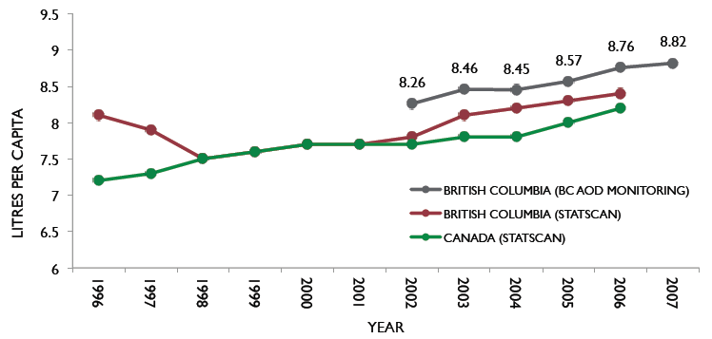
Increase in alcohol consumption in Canada and BC: 1996–2007
Source: Kendall PRW. Updated report from the provincial health officer. 2008

Slide 33
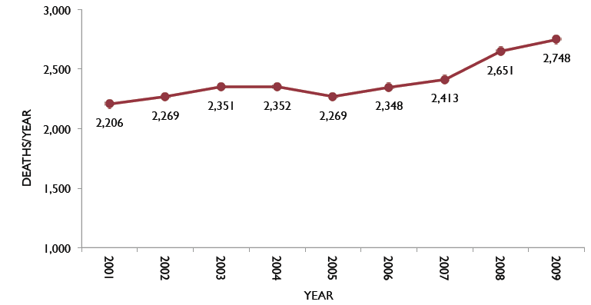
Death from alcoholic liver disease is increasing
Deaths in Canada from alcoholic liver disease
Source: Statistics Canada
Notes:
The death rate from alcoholic liver disease is rising. Data from many countries show that the increase in death rate parallels the increase in alcohol consumption.

Slide 34
Non-alcoholic fatty liver disease

Slide 35
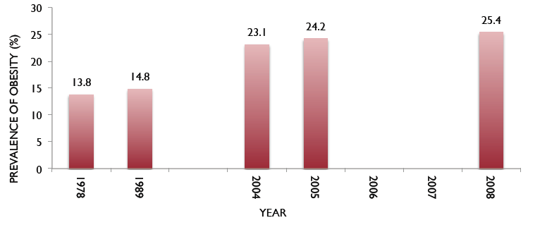
Trends in obesity in Canada
Obesity rates in Canada by year
Source: Obesity_in_canada_2011_en.pdf
Notes:
Obesity is a major risk factor for non-alcoholic fatty liver disease (NAFLD). The increase in obesity rates will result in an increase in NAFLD and all its consequences, namely cirrhosis, liver failure, liver cancer and death.

Slide 36
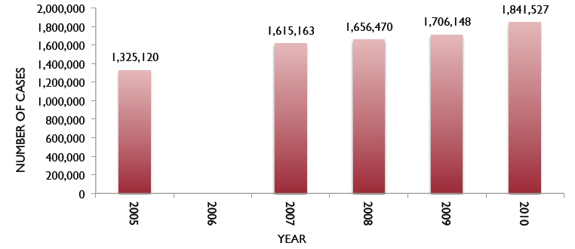
Cases of diabetes by year
Diabetes cases in Canada by year
Source: Statistics Canada
Notes:
Diabetes is a major cause of NAFLD. The increase in diabetes will also result in an increase in NAFLD and it consequences.

Slide 37
Cirrhosis and its complications

Slide 38
ICD codes* that are likely associated with death from cirrhosis
Chronic viral hepatitis | B18 | Alcoholic liver disease | K70
Chronic hepatitis | K73 | Fibrosis and cirrhosis of liver | K74
Hepatic fibrosis | K74.0 | Hepatic failure not specified | K72
Primary biliary cirrhosis | K74.3 | Secondary biliary cirrhosis | K74.4
Biliary cirrhosis, unspecified | K74.5 | Other and unspecified cirrhosis of liver | K74.6
Portal hypertension | K76.6 | Hepatorenal syndrome | K76.7
*In STATSCAN databases
Notes:
Although cirrhosis is coded as such in death registries, there are other conditions that, although not listed as cirrhosis, are consequences of or causes of cirrhosis. For example, death from chronic viral hepatitis really means death from cirrhosis, since patients do not die of chronic viral hepatitis in the absence of cirrhosis. Similarly, death from portal hypertension is almost inevitably associated with cirrhosis. Other causes of death from portal hypertension are rare. Therefore, in assessing the number of deaths from cirrhosis all these conditions are counted as cirrhosis deaths.

Slide 39
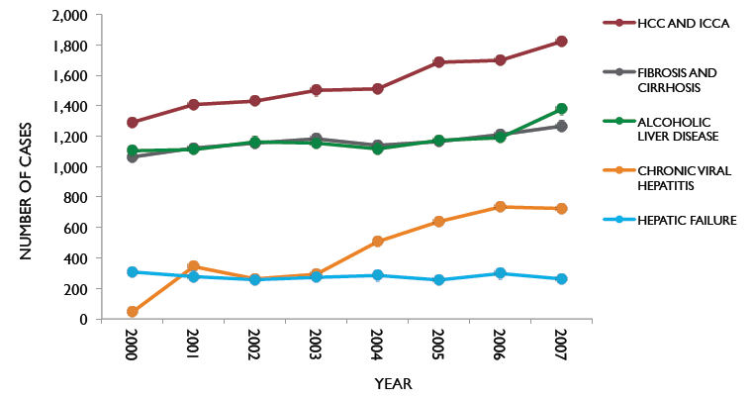
Deaths from liver disease
Deaths from liver disease by selected category and by year
Source: Statistics Canada

Slide 40
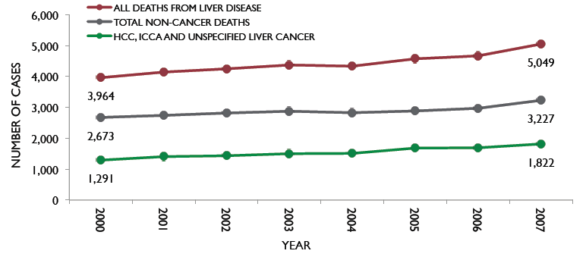
Death from liver disease is increasing in Canada
Deaths from malignant and non-malignant liver disease
Source: Statistics Canada
Notes:
This slide shows that the death rate from all forms of liver disease has increased by 30% over the 8 year period from 2000 to 2007. This is a stunning increase!

Slide 41
Hepatocellular carcinoma

Slide 42
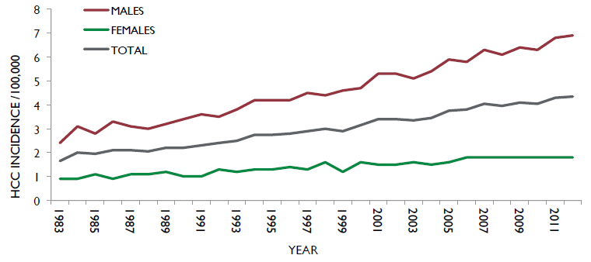
Hepatocellular carcinoma incidence is increasing in Canada
Deaths from malignant liver disease by year
Source: www.cancer.ca
Notes:
Hepatocellular carcinoma incidence and mortality are increasing in Canada. This is one of the few cancers for which the death rate is rising.

Slide 43
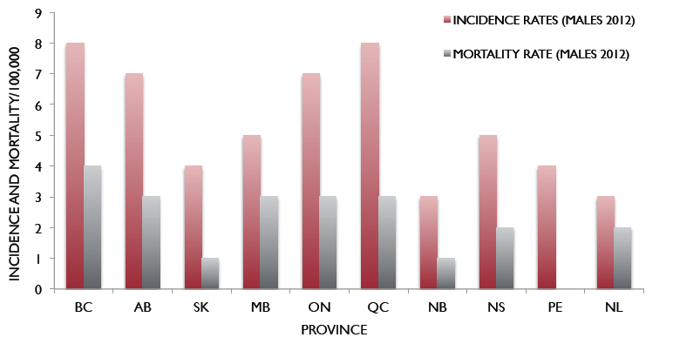
HCC incidence and mortality rates by province (2012)
Source: www.cancer.ca
Notes:
This graph suggests that fewer that 50% of patients with HCC die of their disease. However, this is unlikely to be true. Data on incidence comes from discharge diagnoses and pathology diagnoses. Data on deaths comes from death certificates.
Incidence data under-estimates the true incidence because the rate of biopsy in HCC is low. The diagnosis can be made exclusively by radiology. Death certificate data is well known to be inaccurate, as deaths may be coded as liver failure, cirrhosis, sepsis, variceal bleeding, etc.

Slide 44
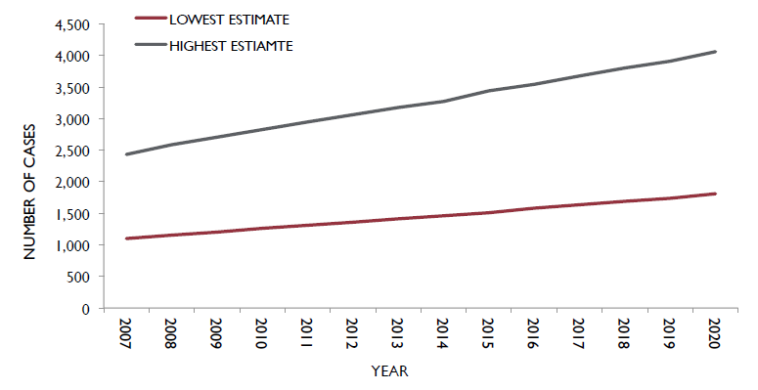
Projected incidence of HCC to 2020
Source: Leber A, et al. Submitted manuscript
Notes:
These numbers are derived from the projected number of cases of hepatitis B in the immigrant population.

Slide 45
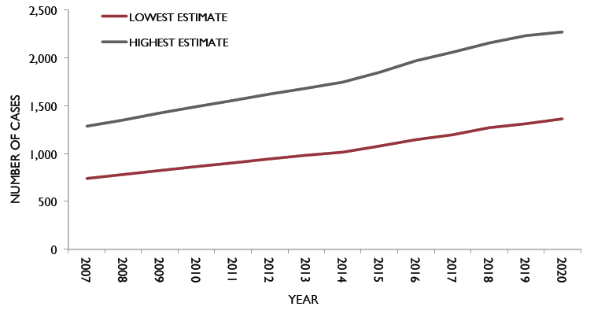
Projected HBV-related HCC mortality to 2020
Source: Leber A, et al. Submitted manuscript
Notes:
These numbers are derived from the projected number of cases of hepatitis B in the immigrant population.

Slide 46
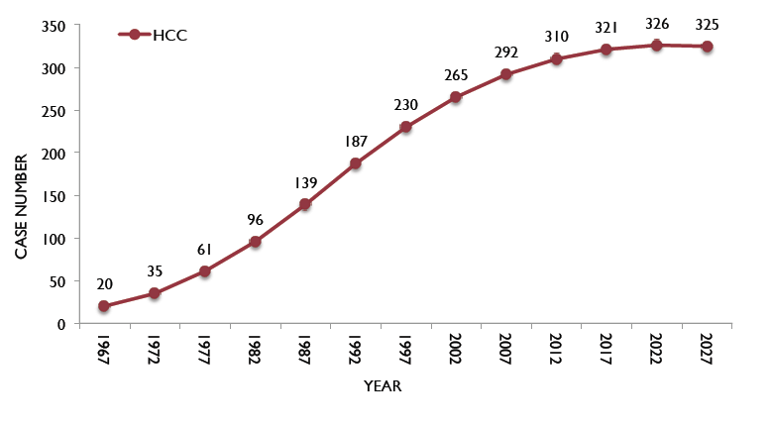
Modeled incidence of HCC related to hepatitis C
Source: Public Health Agency of Canada
Notes:
These numbers are derived from modeling studies.

Slide 47
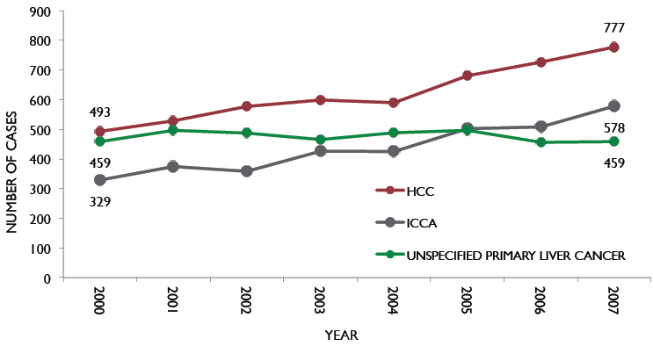
Mortality from primary liver cancers
Source: Statistics Canada
Notes:
Statistics Canada describes three types of primary liver cancer, hepatocellular carcinoma (HCC), intrahepatic cholangiocarcinoma and “unspecified” primary liver cancer. Since the incidence ratio of HCC to ICC is about 6:1 it is likely that most of the “unspecified” cancers are indeed HCC, since other primary cancers of the liver are very rare.

Slide 48
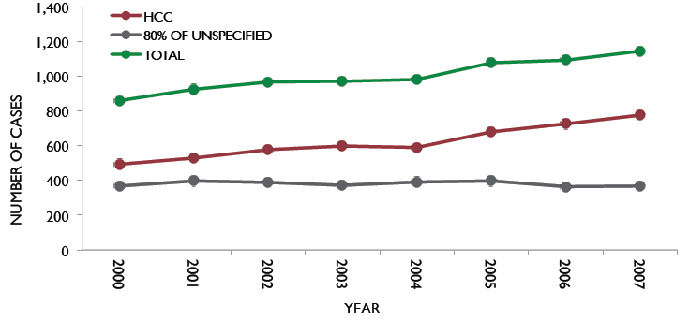
Mortality from HCC corrected for “unspecified” liver cancer
Source: Statistics Canada
Notes:
This graph shows how the mortality from HCC changes if 80% of “unspecified” cancers are counted as HCC.

Slide 49
Resources to manage liver disease in Canada

Slide 50
Resources to manage liver disease
 | Full-time hepatologists | Liver transplantation program | Dedicated hospital beds for liver disease | Specialized liver pathology
BC | 2 | 1 | 0 | No
AB | 20 | 1 | Shared with GI and other services | No
SK | 0 | 0 | 0 | No
MB | 4 | 0 | 0 | No
ON | 20 | 2 | For transplant only, shared | 2
QC | 14 | 2 | Shared, but easy access | 2
NB | 0 | 0 | 0 | No
NS | 2 | 1 | ? | No
PEI | 0 | 0 | 0 | No
NL | 1 | 0 | 0 | No
Sources: Peltekian K, Ma M, Bain V, Lilly L, Kaita K, Witt-Sullivan H, Wong P, Willems B, Villeneuve J-P: personal communications
Notes:
There are only slightly more than 60 trained hepatologists in Canada. This number is increasing, although several previously active hepatologists have retired in the recent few years. There are 8 training programs across the country. There are no hospital beds in the country that are dedicated to patients with chronic liver disease who are not either pre- or post-transplant.
Given the projections of chronic liver disease prevalence in the future these facilities are obviously inadequate.

Slide 51
Gastroenterologists and infectious disease specialists in Canada
Province | Gastroenterologists/hepatologists | Infectious disease
British Columbia | 71 | 36
Alberta | 94 | 54
Saskatchewan | 10 | 10
Manitoba | 15 | 18
Ontario | 259 | 138
Quebec | 133 | 59
New Brunswick | 8 | 5
Nova Scotia | 16 | 10
Prince Edward Island | 1 | 0
Newfoundland | 9 | 3
Yukon | 0 | 0
NWT/Nunavut | 1 | 0
Notes:
Gastroenterologists and infectious disease physicians also look after patients with viral hepatitis. Gastroenterologists look after patients with late stage liver disease as well. However, only a minority of infectious disease physicians are involved in the care of chronic viral hepatitis. It is not clear that there will be sufficient numbers of gastroenterologists to care for the large number of patients with cirrhosis in the future.

Slide 52
Estimated number of physicians treating hepatitis B patients
Province | All physicians treating HBV
British Columbia | 105
Alberta | 90
Saskatchewan | 29
Manitoba | 21
Ontario | 253
Quebec | 225
New Brunswick | 21
Nova Scotia | 20
Prince Edward Island | ?
Newfoundland | 6
Yukon | ?
NWT/Nunavut | ?
Information provided by Gilead Sciences Canada Inc.

Slide 53
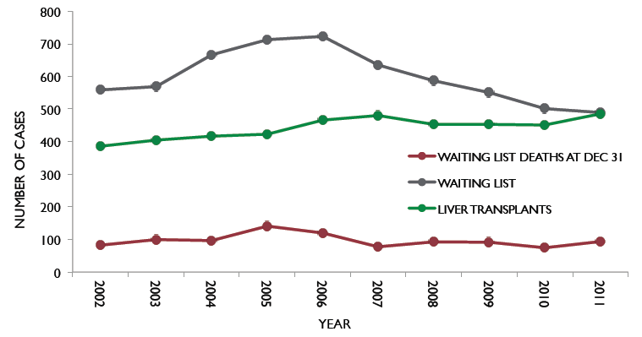
Liver transplantation in Canada
Source: Canadian Organ Replacement Registry. Annual reports 2010, 2011
Notes:
Given that there are about 5,000 liver disease deaths each year and only about 500-600 liver transplants each year it is clear that liver transplantation is not the answer to chronic liver disease.

Slide 54
Costs of liver disease

Slide 55
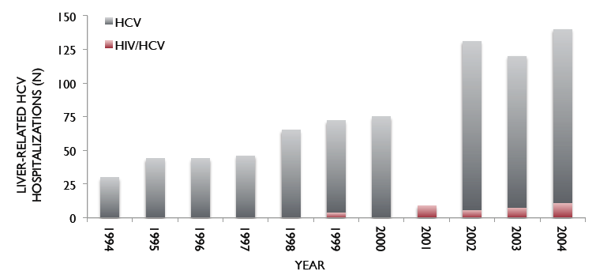
Hospitalizations for hepatitis C-related conditions is are increasing
Liver-related hospitalizations for HCV-related conditions in Calgary health Region by year
Source: Myers RP, et al. Can J Gastroenterol 2008;22:381-7
Notes:
These are the number of hospitalization for conditions related to or caused by chronic hepatitis C by time.

Slide 56
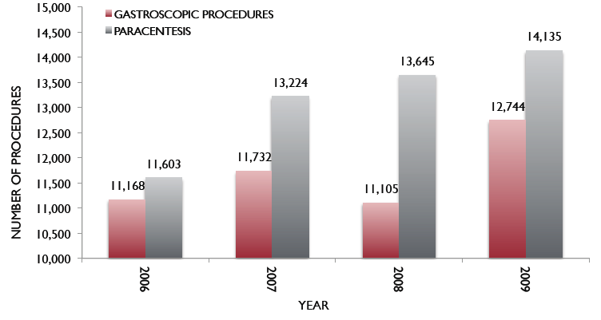
The number of procedures in patients with liver disease is increasing
Procedures in patients with liver disease by year
Source: Federico CA, et al. Liv Int 2012;32:815-25.
Notes:
This graph shows that the number of procedures performed on patients with liver disease is increasing year by year. This is just a snapshot of the likely increases in demand for these procedures in patients with liver disease.

Slide 57
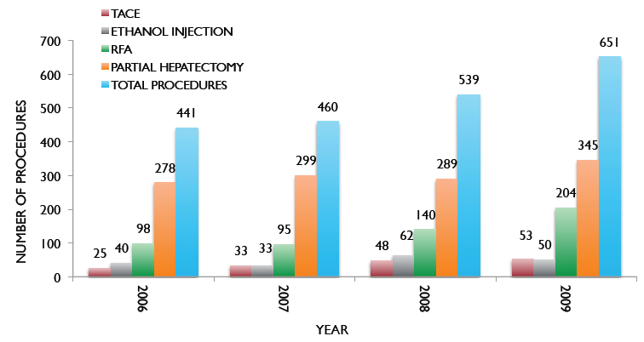
Cancer treatment procedures in patients with liver disease
Procedures in patients with liver cancer by year
Source: Federico CA, et al. Liv Int 2012;32:815-25.
Notes:
This graph shows how procedures associated with the care of liver cancer are also increasing year by year. This is also projected to increase in the future and will, strain the system if the available facilities do not improve in the future.

Slide 58
In-hospital costs for procedures for liver disease patients 2006-2009
Diagnosis | In-hospital costs ($)
GI bleed | 54,498,246
Liver transplant | 28,521,333
Other major intervention | 32,818,416
Cirrhosis/alcoholic hepatitis | 31,000,037
Other liver disease (excluding malignancy) | 10,266,708
Total | 157,104,740
Source: Canadian Institutes of Health Information. 2012.
Notes:
This table shows the costs of procedures and diagnoses related to end stage liver disease. Looking after end stage liver disease is expensive.

